Slide 1
Design and Analysis of Algorithms
Algorithm Writing Style
Dr. Hamid Ali
hamid.ali@ntu.edu.pk

Slide 2
Outline
Introduction
What is an Algorithm?
Design strategies
Analysis of Algorithm
Complexity Theory

Slide 3
What is an Algorithm?
An algorithm is “a finite set of precise instructions for performing a computation or for solving a problem”.
A program is one type of algorithm
All programs are algorithms
Not all algorithms are programs!
Directions to somebody’s house is an algorithm
A recipe for cooking a cake is an algorithm
The steps to compute the cosine of 90° is an algorithm

Slide 4
Some algorithms are harder than others
Some algorithms are easy
Finding the largest (or smallest) value in a list
Finding a specific value in a list
Some algorithms are a bit harder
Sorting a list
Some algorithms are very hard
Finding the shortest path between Miami and Seattle
Some algorithms are essentially impossible
Factoring large composite numbers

Slide 5
Properties of algorithms
Algorithms generally share a set of properties:
Input: what the algorithm takes in as input
Output: what the algorithm produces as output
Definiteness: the steps are defined precisely
Correctness: should produce the correct output
Finiteness: the steps required should be finite
Effectiveness: each step must be able to be performed in a finite amount of time
Generality: the algorithm should be applicable to all problems of a similar form

Slide 6
Algorithm Writing Style
Algorithm can be written in any manner unless they provide the solution of a problem (Correct )
Why to write Algorithm?
Two styles are mostly commonly used:
Pseudo-code
Flow Chart

Slide 7
Programming
We have seen various examples of programming languages
C was an example of a procedural language
Imperative or procedural model
Program executes a sequence of instructions to accomplish a task
FORTRAN, COBOL, BASIC, C, Pascal, Ada, and C++

Slide 8
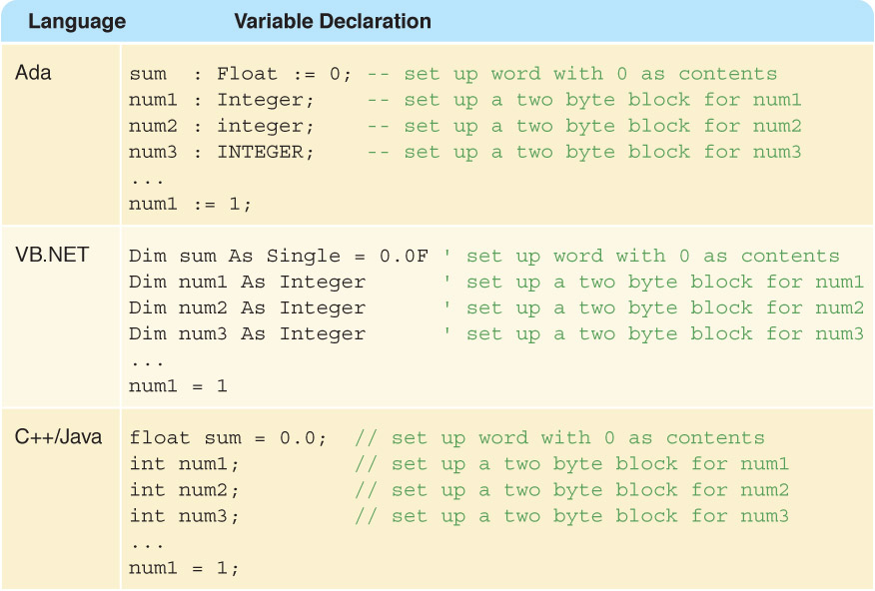
Programming
Let's look back at other models for programming languages:

Slide 9
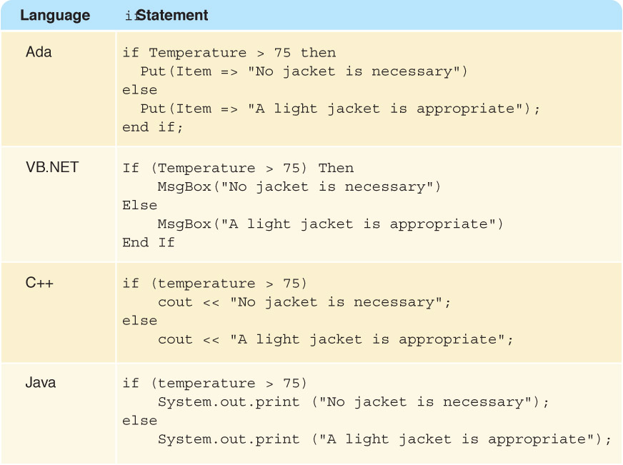
If Statements

Slide 10
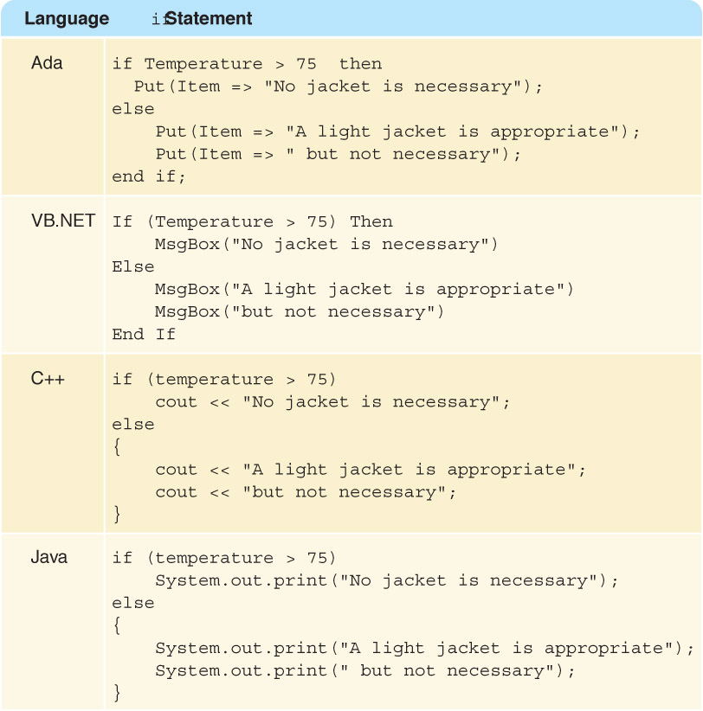
Block of code
How did we do if or while statements in C with multiple lines of code?

Slide 11
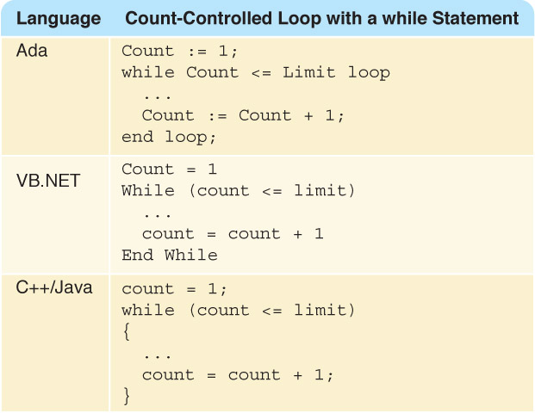
Loops
How did we do while loops in C?

Slide 12
Taking a step back
Suppose I want to describe a program for you to write, but I don't know which language you will use.
We see an example; an algorithm described using comments and asked the user to fill it in.

Slide 13
Write a program to count the length of a message
#include <stdio.h>
main(void)‏
{
char ch;
int length = 0;
//Prompt the user for a message
//Read the first character of the message
//while loop to count how the message is
//print length of message
return 0;
}

Slide 14
Pseudocode
But remember, even comments are different in various languages!
For example, in python, comments are put after % sign instead of //
We need a way to describe a program which is independent of a specific language.

Slide 15
Pseudocode
A way of expressing algorithms that uses a mixture of English phrases and indention to make the steps in the solution explicit
There are no grammar rules in pseudocode
Pseudocode is not case sensitive

Slide 16
Pseudocode Example
Write "How many pairs of values are to be entered?"
Read numberOfPairs
Set numberRead to 0
While (numberRead < numberOfPairs)‏
Write "Enter two values separated by a blank; press return"
Read number1
Read number2
If (number1 < number2)‏
Print number1 + " " + number2
Else
Print number2 + " " number1
Increment numberRead

Slide 17
Flowchart
(Dictionary) A schematic representation of a sequence of operations, as in a manufacturing process or computer program.
(Technical) A graphical representation of the sequence of operations in an information system or program.
Information system flowcharts show how data flows from source documents through the computer to final distribution to users.
Program flowcharts show the sequence of instructions in a single program or subroutine.
Different symbols are used to draw each type of flowchart.

Slide 18
Flowchart
A Flowchart
shows logic of an algorithm
Flowcharts is a graph used to depict or show a step-by-step solution using symbols which represent a task.
e.g., control flow from one action to the next
The symbols used consist of geometrical shapes that are connected by flow lines.
It is an alternative to pseudo coding; whereas a pseudocode description is verbal, a flowchart is graphical in nature.

Slide 19
Flowchart Symbols

Slide 20
Flowchart Example 1
Write an algorithm to determine a student’s final grade and indicate whether it is passing or failing.
The final grade is calculated as the average of four marks.

Slide 21
Flowchart Example 1
START
Step 1: Input M1,M2,M3,M4
Step 2: GRADE  (M1+M2+M3+M4)/4
Step 3: if (GRADE <50) then
Print “FAIL”
else
Print “PASS”
endif
Input
M1,M2,M3,M4
GRADE←(M1+M2+M3+M4)/4
IS
GRADE<50
N
Y
PRINT
“PASS”
PRINT
“FAIL”
STOP

Slide 22
Flowchart Example 2
Write an algorithm and draw a flowchart to convert the length in feet to centimeter.

Slide 23
Flowchart Example 2
Input the length in feet (Lft)
Calculate the length in cm (Lcm) by multiplying LFT with 30
Print length in cm (LCM)
START
Input
Lft
Lcm ← Lft x 30
Print
Lcm
STOP

Slide 24
Flowchart Example 3
Begin
sum = 0
current_number = 1
NO
current_number <= 10?
print sum
YES
sum = sum + current_number
current_number = current_number + 1
End

